Slide 1
Real Property Assessment Tracking and Inter-Office Synchronization System
Municipal Assessor and Treasurer Offices in Pasacao, Camarines Sur (with Provincial Capitol Approval in Pili)
https://www.figma.com/design/1vDr5ctzmgqD0IavesfV2W/Midterm-Design--GRP-23?node-id=0-1&t=1FRmEXOHahRdec4W-1
Group members:
Asido, Christian Louise O.
Calubad, John Kenneth P.
Ortega, Rizalina A.

Slide 2
eRPT Assessment, Valuation, and Tax Declaration Engine
USER PERSONA:
Liza M. Bañares
Assessment Clerk (Age 38)
Municipal Assessor's Office, Pasacao
Skill: Intermediate (Office software, web browser)
Goal
Encode property records rapidly and compute Fair Market Value and Assessed Value without manual formulas.
Pain Points
• Paper archives from 1949 take hours to search during title verification.
• Current eRPT software lacks data fields for complex building sub-components.
• Manual paper preparation causes double work before digital encoding.
Ramon S. Alcantara
Municipal Assessor (Age 52)
Municipal Assessor's Office, Pasacao
Skill: Basic (Document review, appraisal approval)
Goal
Review property valuations accurately and issue digital Recommending Approval dockets on schedule.
Pain Points
• Handwritten appraisal sheets contain calculation errors in assessment levels.
• Incomplete supporting documents delay endorsement packets for weeks.
• Lack of queue visibility hides transaction delays across assessment stages.
Elena V. Ramos
Property Owner / Taxpayer (Age 45)
Barangay Santa Rosa del Norte, Pasacao
Skill: Novice (Basic smartphone, text messaging)
Goal
Submit property assessment documents and verify requirements without repeated counter visits.
Pain Points
• Arriving at municipal hall only to learn that required documents are missing.
• Travel costs and long waiting lines to check simple application status.
• No online checklist exists to verify required submissions in advance.

Slide 3
JOURNEY MAP: Municipal Assessment Clerk Processing Assessment & Valuation
Scenario: Citizen submits a New Assessment or Transfer request (Baseline: 7+ days | Target: Automated digital appraisal in <24 hours)
Liza M. Bañares
Assessment Clerk (Age 38)
Operational Context
Validates property conveyance deeds, searches tax declaration archives, enters building sub-components, and computes valuations.
Process Structure
The workflow covers five phases: pre-screening, archive search, automated valuation, digital tax declaration, and recommending docket creation.
DIMENSION | 1. Pre-Screening | 2. Archive Lookup | 3. Automated Valuation | 4. Digital Tax Declaration | 5. Recommending Docket
ACTIONS | Receives deed of sale and title. Checks paper checklist. Enters applicant data into logbook. | Searches physical metal cabinets for legacy 1949 tax declarations. Verifies Property Index Number. | Enters property area and classification. System applies SMV unit rate and assessment level. | Generates digital Tax Declaration, Notice of Assessment, and appraisal schedule sheet. | Assessor signs Recommending Approval. Exports assessment roll packet for Treasury and Capitol.
EMOTIONS | Focused Worried about missing supporting documents and applicant queue. | Frustrated Brittle paper records are torn, unindexed, and difficult to decipher. | Relieved Software computes Fair Market Value instantly without manual math. | Confident Standardized digital form eliminates handwritten clerical errors. | Satisfied Recommending docket is ready for digital endorsement without transit delays.
SOLUTION IDEAS | Digital checklist pre-screens requirements online. System assigns a tracking number instantly. | Indexed database search retrieves property history by Property Index Number within two seconds. | Automated computation engine calculates Fair Market Value and Assessed Value under RA 7160. | System generates electronic Tax Declaration with complete building sub-component fields. | Digital docket packaging attaches verified documents for instant export to Modules 2 and 3.

Slide 4
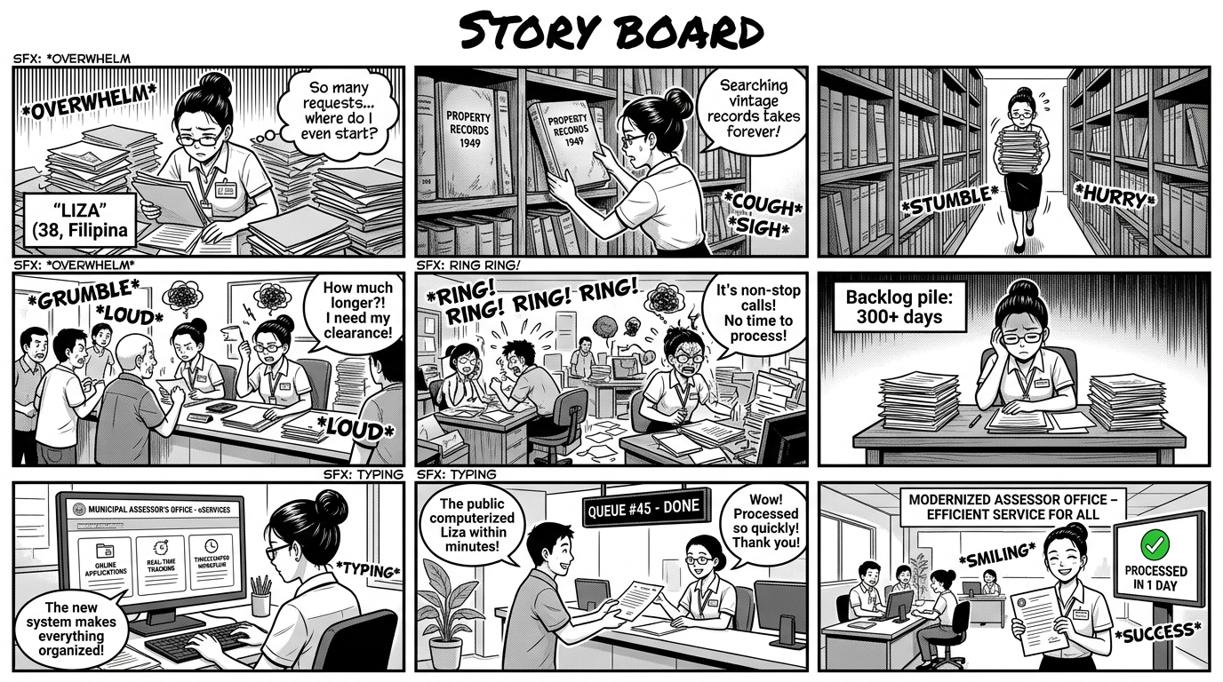
STORY BOARD: eRPT Assessment, Valuation, and Tax Declaration Engine

Slide 5
USER & SYSTEM REQUIREMENTS SPECIFICATION
USER 1: MUNICIPAL ASSESSMENT CLERK
Assessment clerks encode property details, verify supporting conveyances, and calculate statutory property valuations.
USER REQUIREMENTS
The system must provide digital checklists, automated valuation computation, and digital Tax Declaration generation.
SYSTEM REQUIREMENTS
• Functional Requirements:
○ FR1.1: The system must record property assessment requests with property classification and Property Index Number.
○ FR1.2: The system must calculate Fair Market Value automatically from encoded area and Schedule of Market Values.
○ FR1.3: The system must calculate Assessed Value automatically using statutory assessment levels under Republic Act 7160.
○ FR1.4: The system must capture building sub-components including structural type, floor area, year built, and depreciation.
○ FR1.5: The system must export completed Assessment Rolls in standardized format for Treasury billing import.
• Non-Functional Requirements:
○ NF1.1: The system must retrieve property search results in less than two seconds.
○ NF1.2: The system must restrict record editing to authorized municipal assessment staff using role permissions.
○ NF1.3: The system must maintain an audit log of all property valuation edits with user timestamps.
○ NF1.4: The system must mask personal identifying data in compliance with Republic Act 10173.

Slide 6
USER & SYSTEM REQUIREMENTS SPECIFICATION
USER 2: MUNICIPAL ASSESSOR
The Municipal Assessor inspects property appraisals, confirms statutory rates, and signs Recommending Approval endorsements.
USER REQUIREMENTS
The system must provide digital appraisal review queues, valuation verification screens, and docket endorsement bundling.
SYSTEM REQUIREMENTS
• Functional Requirements:
○ FR2.1: The system must display an organized review queue of all pending property appraisal dockets.
○ FR2.2: The system must generate digital Tax Declarations containing statutory Recommending Approval notation.
○ FR2.3: The system must flag assessment requests that remain pending review for more than three days.
○ FR2.4: The system must support property transaction types including discovery, transfer, reassessment, and cancellation.
• Non-Functional Requirements:
○ NF2.1: The review queue interface must render appraisal schedules in less than three seconds.
○ NF2.2: The Recommending Approval endorsement must require verified assessor login credentials.
○ NF2.3: The system must preserve historical valuation records for statutory audit compliance.

Slide 7
USER & SYSTEM REQUIREMENTS SPECIFICATION
USER 3: PROPERTY OWNER / TAXPAYER
Property owners file assessment applications and need clear requirements to avoid repeated trips to the municipal hall.
USER REQUIREMENTS
The system must provide an accessible digital document checklist and an inquiry tool to track assessment status.
SYSTEM REQUIREMENTS
• Functional Requirements:
○ FR3.1: The system must provide an online pre-screening checklist for deeds, titles, and building permits.
○ FR3.2: The system must display missing document notices before the citizen visits the municipal hall.
○ FR3.3: The system must allow taxpayers to check assessment status using a unique tracking number.
○ FR3.4: The system must display the current processing milestone of the submitted assessment application.
• Non-Functional Requirements:
○ NF3.1: The public checklist portal must function on smartphone web browsers without software installation.
○ NF3.2: The status query page must load in less than three seconds on standard mobile networks.
○ NF3.3: The system must protect property ownership data in compliance with Republic Act 10173.

Slide 8
Treasurer's Office Tax Collection and Billing Management Module
USER PERSONA:
Carmen R. Villaluz
Treasury Cashier / Collector (Age 42)
Municipal Treasurer's Office, Pasacao
Skill: Intermediate (Cash drawers, receipt printing)
Goal
Process walk-in tax payments accurately and compute discounts and penalties without manual arithmetic.
Pain Points
• Manual calculation of quarterly penalties (2% per month) causes long lines.
• Physical paper receipts require tedious matching against paper ledger books.
• Manual receipt re-entry leads to reconciliation errors during audit periods.
Arthur T. Morales
Municipal Treasurer (Age 55)
Municipal Treasurer's Office, Pasacao
Skill: Basic to Intermediate (Revenue oversight)
Goal
Monitor tax revenue targets, track delinquent accounts, and issue verified electronic tax clearances.
Pain Points
• Assessment Rolls arrive through manual paper submission from the Assessor.
• No automated tool flags delinquent accounts or calculates accumulated back taxes.
• Cross-checking tax clearances against manual ledgers takes multiple days.
Danilo S. Perez
Real Property Taxpayer (Age 49)
Poblacion, Pasacao
Skill: Basic (Mobile phone, bank transactions)
Goal
Receive an itemized billing statement and secure an official Tax Clearance immediately after payment.
Pain Points
• No pre-billing statement is issued before the annual payment deadline.
• Confusion regarding discount rates (20% versus 10%) on quarterly payments.
• Waiting days to receive a signed Tax Clearance required for property sale.

Slide 9
JOURNEY MAP: Treasury Cashier Processing Tax Billing, Collection & Tax Clearance
Scenario: Taxpayer settles annual or quarterly tax dues (Baseline: 3–5 days manual ledger check | Target: Instant billing & digital clearance)
Carmen R. Villaluz
Treasury Cashier (Age 42)
Operational Context
Imports assessment data, issues tax billing statements, processes cash payments, and issues official receipts and clearances.
Process Structure
The workflow covers five phases: roll import, automated tax calculation, payment receipting, ledger posting, and tax clearance issuance.
DIMENSION | 1. Roll Import | 2. Automated Tax Due | 3. Payment Receipting | 4. Instant Ledger Posting | 5. Issuing Clearance
ACTIONS | Imports digital Assessment Roll from Module 1 without manual typing. Verifies PIN and Assessed Value. | System computes Basic Tax (1%) and SEF (1%). Applies prompt discounts or monthly penalties. | Cashier collects cash or check payment. System records transaction and prints Official Receipt. | Database posts payment record instantly. Updates property balance to zero in treasury ledger. | System validates zero outstanding balance and generates official printable Tax Clearance.
EMOTIONS | Relieved Eliminates manual re-entry of hundreds of property assessment records. | Confident Automated discounts and penalties remove arithmetic errors completely. | Efficient Cashier completes transaction quickly and reduces counter queue. | Reassured Ledger updates automatically without end-of-day manual tallying. | Pleased Taxpayer receives official Tax Clearance during the same counter visit.
SOLUTION IDEAS | Digital import interface transfers Assessment Roll data directly from Module 1. | Automated computation engine calculates Basic Tax, SEF, discounts, and penalties under RA 7160. | Electronic cashier module captures payment details and prints standardized Official Receipts. | Centralized relational database synchronizes payment balances instantly across accounts. | Automated clearance generator issues verifiable Tax Clearances for zero-balance properties.

Slide 10
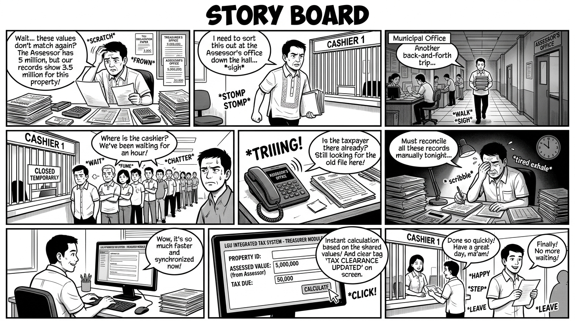
STORY BOARD: Treasurer's Office Tax Collection and Billing Management Module

Slide 11
USER & SYSTEM REQUIREMENTS SPECIFICATION
USER 1: TREASURY COLLECTION CLERK / CASHIER
Collection clerks search property tax records, collect payments, and issue official municipal receipts.
USER REQUIREMENTS
The system must display pre-computed tax dues, calculate discounts and penalties, and print official receipts.
SYSTEM REQUIREMENTS
• Functional Requirements:
○ FR1.1: The system must import Assessment Roll data directly from Module 1 without manual re-entry.
○ FR1.2: The system must calculate Basic Real Property Tax (1%) and Special Education Fund (1%) under RA 7160.
○ FR1.3: The system must compute prompt payment discounts (20% and 10%) and monthly penalties (2% up to 72%).
○ FR1.4: The system must record payment transactions and print official receipts showing amount, year, and date.
○ FR1.5: The system must support quarterly installment schedules due on March 31, June 30, September 30, and December 31.
• Non-Functional Requirements:
○ NF1.1: The system must return taxpayer record search results in less than two seconds.
○ NF1.2: The system must enforce atomic transactions to prevent payment data loss during network disruptions.
○ NF1.3: The collection interface must maintain high responsiveness during annual peak tax periods.

Slide 12
USER & SYSTEM REQUIREMENTS SPECIFICATION
USER 2: MUNICIPAL TREASURER
The Municipal Treasurer monitors revenue performance, tracks delinquent properties, and authorizes official tax clearances.
USER REQUIREMENTS
The system must provide collection summary dashboards, automated delinquency tracking, and digital tax clearance generation.
SYSTEM REQUIREMENTS
• Functional Requirements:
○ FR2.1: The system must generate daily, monthly, and annual real property tax collection summary reports.
○ FR2.2: The system must flag delinquent properties automatically and compute accumulated penalties.
○ FR2.3: The system must generate verifiable Tax Clearance documents for properties with zero outstanding tax balance.
○ FR2.4: The system must export delinquency lists formatted for municipal enforcement and statutory reporting.
• Non-Functional Requirements:
○ NF2.1: Executive collection dashboards must update balances automatically after every posted payment.
○ NF2.2: The system must protect financial collection records with encryption during transmission and storage.
○ NF2.3: The system must record user credentials and exact timestamps for all generated tax clearances.

Slide 13
USER & SYSTEM REQUIREMENTS SPECIFICATION
USER 3: REAL PROPERTY TAXPAYER / PROPERTY OWNER
Taxpayers settle annual or quarterly property taxes and require itemized billing statements and payment confirmation.
USER REQUIREMENTS
The system must generate clear billing statements showing tax due, discounts, penalties, and installment due dates.
SYSTEM REQUIREMENTS
• Functional Requirements:
○ FR3.1: The system must generate itemized billing statements displaying Basic Tax and Special Education Fund levies.
○ FR3.2: The system must show applicable prompt payment discounts and penalty amounts clearly on the bill.
○ FR3.3: The system must provide quarterly installment breakdowns with statutory due dates.
○ FR3.4: The system must issue printable payment receipts stating property details, tax year, and amount paid.
• Non-Functional Requirements:
○ NF3.1: The system must format billing statements in standard printable layout for frontline municipal release.
○ NF3.2: The system must mask personal taxpayer details on public inquiry screens under Republic Act 10173.
○ NF3.3: The billing inquiry interface must display complete account statements in less than two seconds.

Slide 14
Provincial Capitol Remote Endorsement & Digital Approval Pipeline
USER PERSONA:
Engr. Rodrigo E. Peña
Provincial Review Examiner (Age 44)
Technical Review Unit, Provincial Capitol, Pili
Skill: Advanced (Cadastral review, statutory appraisal)
Goal
Inspect municipal endorsement dockets online and audit valuation compliance without handling heavy paper bundles.
Pain Points
• Paper dossiers from 35 municipalities arrive weekly and create huge backlogs.
• Physical paper cross-referencing against provincial schedules takes days.
• Returning deficient dockets requires waiting for the next weekly courier run.
Atty. Gerardo M. San Juan
Provincial Assessor (Age 58)
Provincial Assessor's Office, Provincial Capitol, Pili
Skill: Intermediate (Statutory approvals, legal oversight)
Goal
Execute official statutory approvals digitally with cryptographic security and issue certified CIS documents rapidly.
Pain Points
• Manual physical signing of thousands of paper sheets causes multi-week delays.
• Risk of forged signatures or altered property valuations on physical sheets.
• Lack of digital tracking hides review bottlenecks across municipal queues.
Liza M. Bañares
Municipal Endorsement Officer (Age 40)
Municipal Assessor's Office, Pasacao
Skill: Intermediate (Docket bundling, portal tracking)
Goal
Bundle and submit digital endorsement packets to the Capitol and monitor provincial approval in real time.
Pain Points
• Traveling by road to the Provincial Capitol in Pili once a week to submit files.
• Severe weather and road hazards disrupt weekly document deliveries.
• Citizen complaints regarding 7 to 14 days of idle waiting time during Capitol review.

Slide 15
JOURNEY MAP: Municipal & Provincial Reviewers Processing Capitol Endorsement
Scenario: Municipal Assessor submits transfer docket to Provincial Capitol in Pili (Baseline: 7–14 days | Target: <24 hours remote digital approval)
Engr. Rodrigo E. Peña
Provincial Examiner (Age 44)
Operational Context
Audits digital endorsement dockets from 35 LGUs, verifies appraisal calculations, notes deficiencies, and queues files for final signing.
Process Structure
The workflow covers five phases: docket upload, dual-pane inspection, statutory audit, cryptographic signing, and automated dispatch.
DIMENSION | 1. Docket Upload | 2. Dual-Pane Audit | 3. Compliance Check | 4. Digital Signing | 5. Instant Dispatch
ACTIONS | Municipal staff bundles appraisal sheet, deed of sale, and survey sketch into digital dossier. | Provincial examiner opens docket in dual-pane viewer. Inspects boundary survey and title deeds. | Examiner verifies Schedule of Market Values compliance. Flags deficiencies or clears file. | Provincial Assessor executes approval. System affixes cryptographic SHA-256 stamp and token. | System generates printable Certificate of Inspection and Survey (CIS) with QR code.
EMOTIONS | Relieved Eliminates physical weekly car trips to Pili through mountain and highway roads. | Focused Dual-pane screen allows rapid side-by-side inspection without shuffling papers. | Methodical Structured checklist ensures complete compliance across all 35 municipalities. | Confident Cryptographic digital seal guarantees document integrity and prevents forgery. | Satisfied Approved documents return to municipal databases in seconds instead of weeks.
SOLUTION IDEAS | Encrypted docket bundling tool uploads certified PDF packets directly to the Capitol pipeline. | Provincial review workspace provides synchronized dual-pane viewer and annotation tools. | Automated SMV variance checking cross-references appraisal inputs against provincial tables. | Digital signing module embeds cryptographic SHA-256 signature stamp and verification token. | Real-time dispatch engine delivers approved CIS and Tax Declarations back to LGU databases.

Slide 16
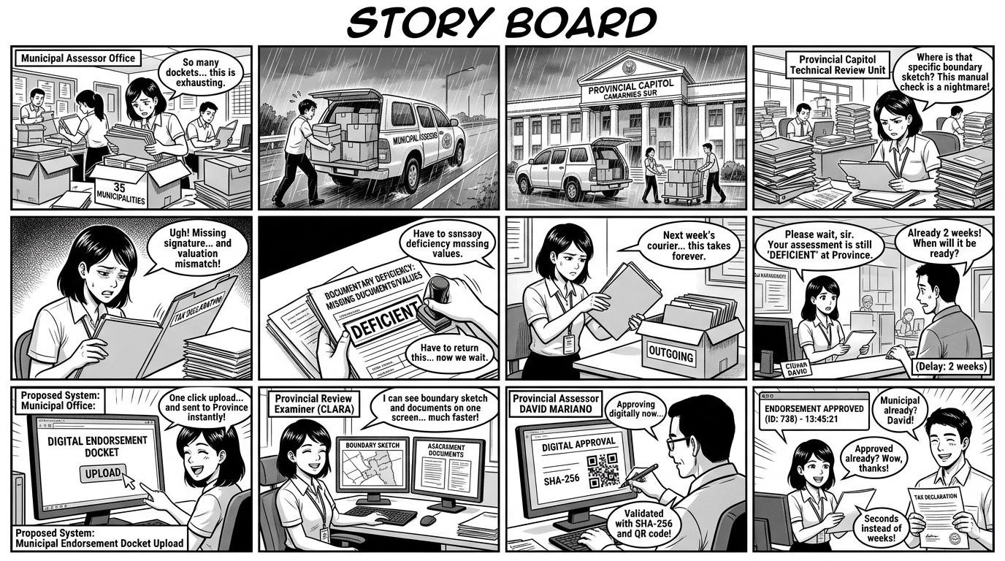
STORY BOARD: Provincial Capitol Remote Endorsement & Digital Approval Pipeline

Slide 17
USER & SYSTEM REQUIREMENTS SPECIFICATION
USER 1: MUNICIPAL ENDORSEMENT OFFICER
Municipal endorsement officers prepare assessment dossiers and submit them to the Capitol for statutory approval.
USER REQUIREMENTS
The system must allow digital dossier bundling, online submission, and real-time tracking of Capitol review queues.
SYSTEM REQUIREMENTS
• Functional Requirements:
○ FR1.1: The system must bundle appraisal sheets, deeds of sale, and survey sketches into encrypted digital dockets.
○ FR1.2: The system must upload endorsement dockets directly to the Provincial Assessor pipeline without physical courier transit.
○ FR1.3: The system must display the live Capitol review status and queue position of submitted dockets.
○ FR1.4: The system must notify municipal personnel immediately when a docket requires corrective deficiency revision.
• Non-Functional Requirements:
○ NF1.1: The system must upload dockets up to twenty-five megabytes in less than thirty seconds.
○ NF1.2: The system must enforce AES-256 encryption on all stored and transmitted endorsement dockets.
○ NF1.3: The municipal portal must function reliably on standard municipal internet connections.

Slide 18
USER & SYSTEM REQUIREMENTS SPECIFICATION
USER 2: PROVINCIAL REVIEW EXAMINER (CAPITOL TECHNICAL REVIEW UNIT)
Provincial examiners inspect municipal assessment dockets to ensure compliance with provincial appraisal standards.
USER REQUIREMENTS
The system must provide dual-pane document viewers, compliance checklists, and structured deficiency annotation tools.
SYSTEM REQUIREMENTS
• Functional Requirements:
○ FR2.1: The system must provide a web interface with dual-pane document viewer and zoom inspection controls.
○ FR2.2: The system must display an interactive statutory compliance checklist for each submitted municipal docket.
○ FR2.3: The system must flag valuation discrepancies against the provincial Schedule of Base Market Values table.
○ FR2.4: The system must allow examiners to return dockets with itemized deficiency notes and corrective instructions.
• Non-Functional Requirements:
○ NF2.1: The dual-pane inspection interface must open high-resolution document pages in less than two seconds.
○ NF2.2: The system must log every examiner inspection, annotation, and return action in an immutable audit trail.
○ NF2.3: The system must maintain session security with automatic logout after fifteen minutes of inactivity.

Slide 19
USER & SYSTEM REQUIREMENTS SPECIFICATION
USER 3: PROVINCIAL ASSESSOR (CAPITOL CHIEF APPROVER)
The Provincial Assessor holds statutory final approval authority for all property assessments in Camarines Sur.
USER REQUIREMENTS
The system must support cryptographic digital signing, automated CIS generation, and instant bidirectional dispatch.
SYSTEM REQUIREMENTS
• Functional Requirements:
○ FR3.1: The system must enable official digital approval execution with cryptographic SHA-256 signature stamps.
○ FR3.2: The system must generate Certificate of Inspection and Survey documents with embedded verification QR codes.
○ FR3.3: The system must dispatch approved dockets back to municipal assessor and treasury databases in under one second.
○ FR3.4: The system must support batch endorsement approval for multiple pre-audited dockets during peak cycles.
• Non-Functional Requirements:
○ NF3.1: Cryptographic digital stamps must use SHA-256 hashing to guarantee unalterable document authenticity.
○ NF3.2: The system must maintain ninety-nine point five percent uptime during provincial government working hours.
○ NF3.3: The system must retain complete digital audit logs for ten years under statutory audit rules.

